Slide 1
Answering Objections to Christianity
Stuart Smith
stuart@apologeticsgeek.com

Slide 2
Review
Acts 1:8 – You will be my witnesses in Jerusalem, Judea Samaria, and the ends of the earth
Our “Jerusalem” is what we often perceive is the hardest part of evangelism
Three questions to use in conversation:
What do you mean by that?
How did you come to that conclusion?
Have you ever considered…?

Slide 3
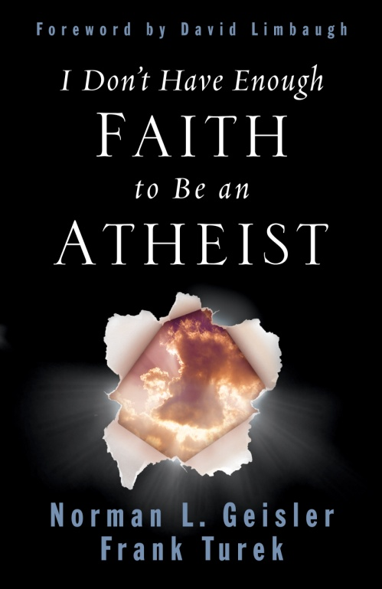
Does Truth Exist?
Are Miracles Possible?
Is the New Testament Reliable?
Does God Exist?

Slide 4
Does Truth Exist?
Are Miracles Possible?
Is the New Testament Reliable?
Does God Exist?

Slide 5
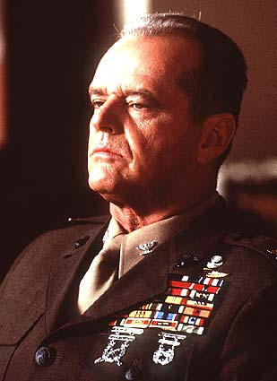
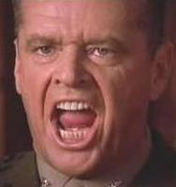
WHAT IS TRUTH ?
You can’t handle
the Truth!
TRUTH IS… Telling it like it is!
Notes:
I Don't Have Enough Faith to Be An Atheist
5/14/19
By Dr. Frank Turek www.ImpactApologetics.com
5
5

Slide 6
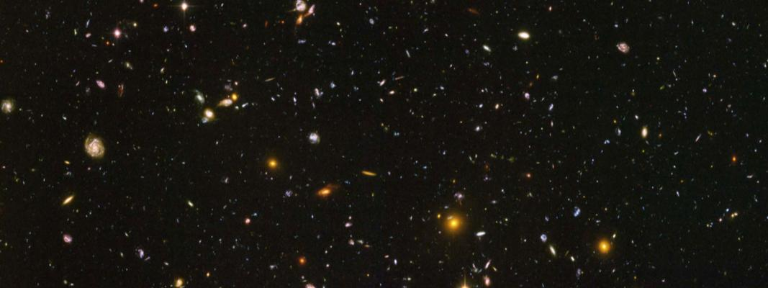

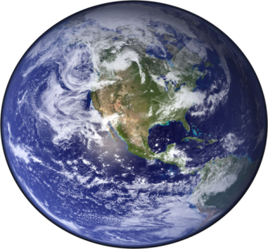
THE LAW OF NON-CONTRADICTION
Helps Us Discover What is False
Opposite ideas cannot both be true
at the same time and in the same sense.
The Earth is Round
The Earth is NOT Round

Slide 7

THE LAW OF NON-CONTRADICTION
The Law Of Non-contradiction Is Undeniable
Even those who deny it… use it.

Slide 8

THE LAW OF NON-CONTRADICTION
“Anyone who denies the law of non-contradiction should be beaten and burned until he admits that to be beaten is not the same as not to be beaten, and to be burned is not the same as not to be burned.”
(Avicenna, Great Medieval Philosopher)

Slide 9
All Truth is Absolute
Something that is true is true
for All Persons
at All Times
in All Places!

Slide 10
Types of Truth
Subjective
(mind dependent)
Objective
(mind independent)

Slide 11
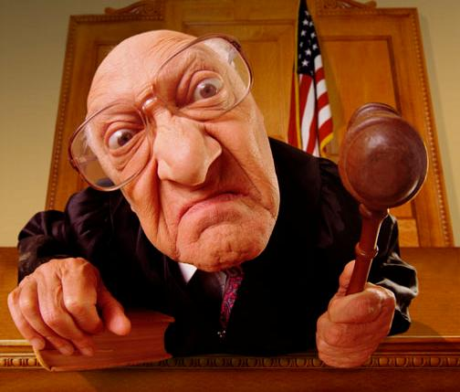
Objections to Absolute Truth
There is no truth!
You can’t know truth!
All truth is relative!
It’s true for you… but not for me!
No one has the truth!
You ought not judge!

Slide 12
Your Greatest Tool in Answering These Objections:
Apply the claim to itself!
Example . . .

Slide 13
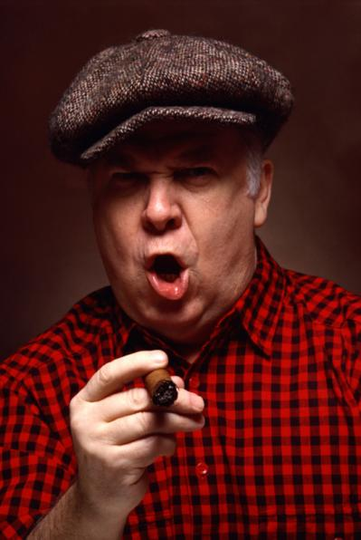

If someone were to say…
“I can’t speak a word in English.”
“Didn’t he say that in English?”

Slide 14
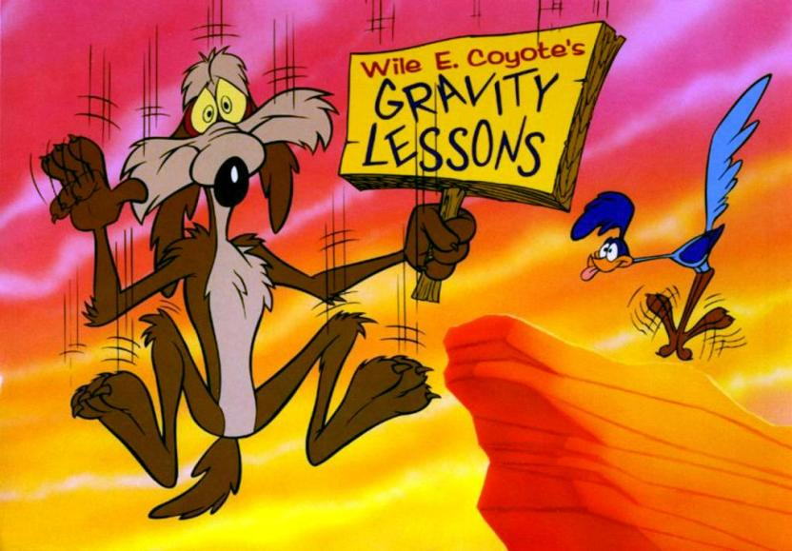
We call this… “The Road Runner Tactic”
Because the person making the claim has no ground to stand on.

Slide 15

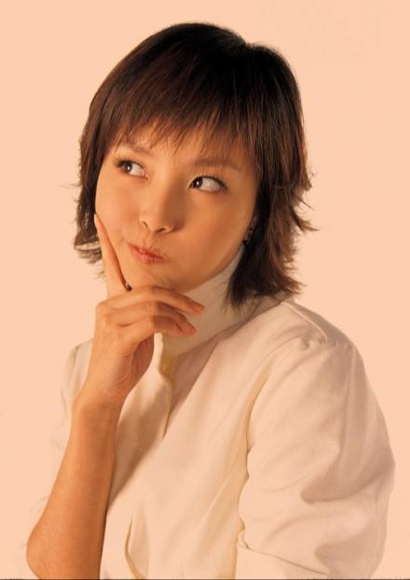
“There is no truth.”
“Is that true?”

Slide 16
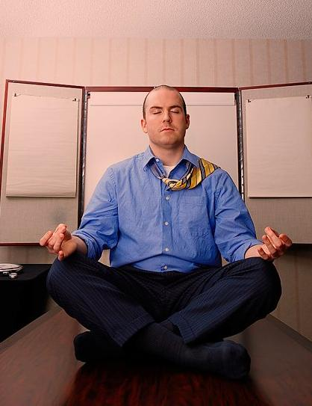
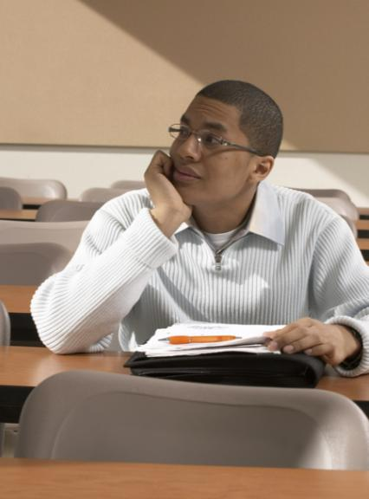
“There is no such thing as absolute truth!”
“Are you absolutely sure?”

Slide 17
The Truth about Truth
1. Contrary beliefs are possible, but contrary truths are not possible.
2. You can believe everything is true, but everything can’t be true.
3. Objective truth can’t be denied without being affirmed.
Notes:
I Don't Have Enough Faith to Be An Atheist
5/14/19
By Dr. Frank Turek www.ImpactApologetics.com
17
17

Slide 18
Few people will actually deny that truth exist…
…but they will try and relativize it.

Slide 19
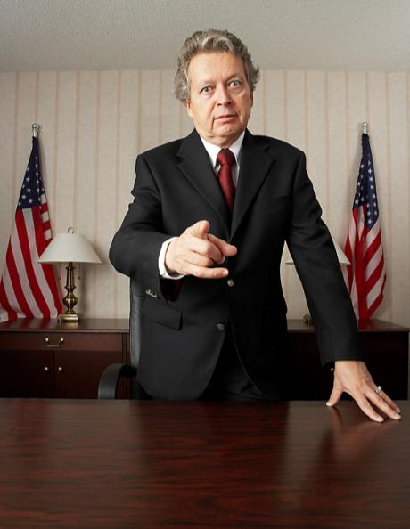

Realtivism
“It’s true for you but not for me!”
“Is that true for everybody?”

Slide 20
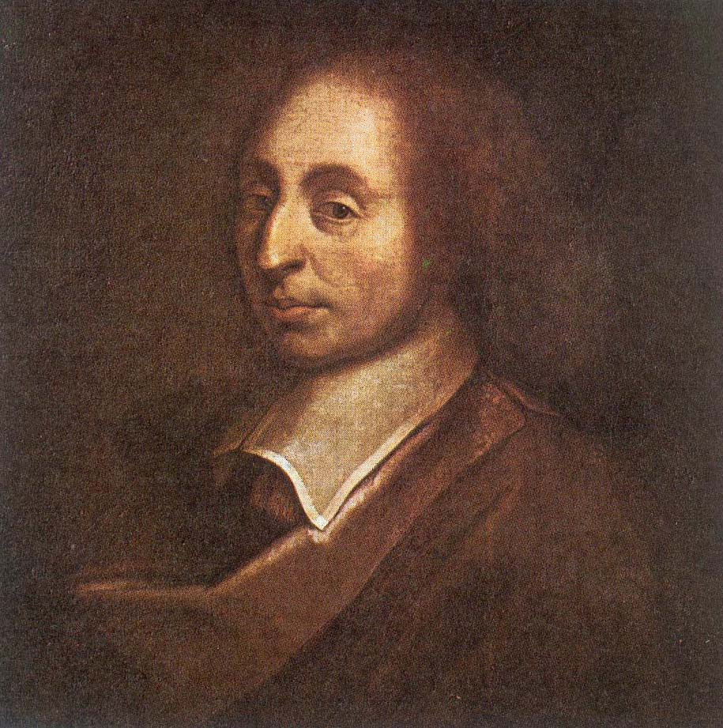
“People almost invariably arrive at their beliefs not on the basis of proof but on the basis of what they find attractive.”
Pascal
Notes:
20

Slide 21
Does Truth Exist?
Are Miracles Possible?
Is the New Testament Reliable?
Does God Exist?

Slide 22



THREE MAJOR RELIGIOUS WORLD VIEWS
Judaism
Christianity
Islam
Zen Buddhism
Hinduism
New Age
Religious
Humanism
THEISM
PANTHEISM
ATHEISM
God Made All
God Is All
No God At All

Slide 23
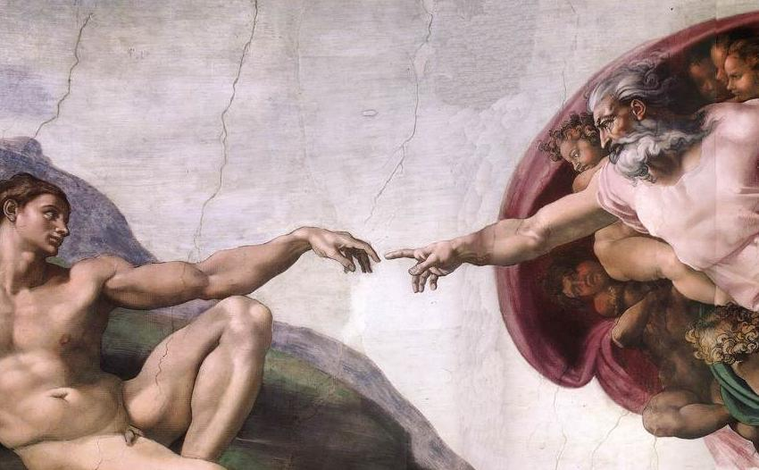
THREE GREAT ARGUMENTS
for a theistic God
BEGINNING:
DESIGN:
MORALITY:
Cosmological Argument
Teleological Argument
Moral Argument
Notes:
23

Slide 24
The Kalam Cosmological Argument
Everything that begins to exist has a cause.
The universe began to exist.
Therefore, the universe had a causel
Notes:
24

Slide 25
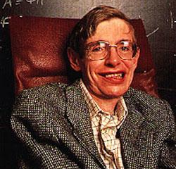
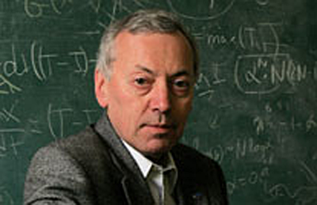
SCIENTISTS STATE:
there was a beginning
“Almost everyone now believes that the universe, and time itself, had a beginning at the Big Bang.”
Stephen Hawking
“With the proof now in place, cosmologists can no longer hide behind the possibility of a past-eternal universe. There is now no escape, they have to face the
problem of a cosmic beginning.”
Alexander Vilenkin
Notes:
25

Slide 26
SCIENTIFIC EVIDENCE THAT
the universe had a beginning
S
ECOND LAW OF THERMODYNAMICS
NIVERSE IS EXPANDING
ADIATION AFTERGLOW
REAT GALAXY SEEDS
INSTEIN’S GENERAL RELATIVITY
U
R
G
E
Notes:
26

Slide 27

IF THE UNIVERSE HAD A BEGINNING
then it must have had a Beginner
The evidence leaves us with the following two options:
1. No One Created Something Out Of Nothing
(atheistic view)
EITHER
OR
2. Someone Created Something Out Of Nothing
(theistic view)
Question To Ask An Atheist
Which view is more reasonable ?
“If there is no God, why is there some-thing rather than nothing at all?”

Slide 28
The Nature of the Cause?
The evidence shows there is a cause for the Universe
1. Material cause?
Infinite regress problem!
2. Agent cause?
Uncaused first cause!

Slide 29
The Nature of the Cause?
If the beginning of the universe was the beginning of all space, time, and matter then the cause must be…
This is starting to sound a lot like the God of the Bible
Spaceless
Timeless
Immaterial
Powerful
Intelligent
Personal

Slide 30
THREE GREAT ARGUMENTS
for a theistic God
BEGINNING:
DESIGN:
MORALITY:
Cosmological Argument
Teleological Argument
Moral Argument
Notes:
30

Slide 31

If you found this watch in the woods, would you think it was made by natural law?

Slide 32
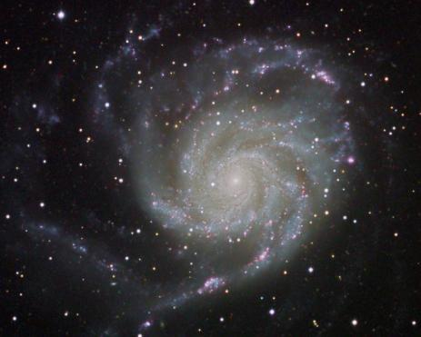
THE TWO FUNDAMENTAL
origin questions
WHAT CAUSED THE:
1. Universe ?
2. Life ?
Notes:
32

Slide 33
Extreme Precision
at the beginning
If the expansion rate of the universe was different by one part in a thousand, million, million a second after the big bang, the universe would have collapsed back on itself or never developed galaxies.
Stephen Hawking
Notes:
33

Slide 34
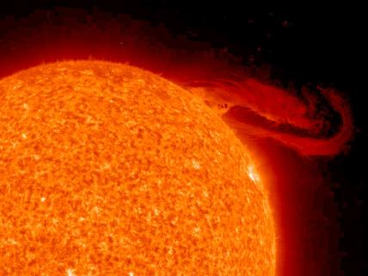
Extreme Precision
Right Now
If the gravitational force were altered more than 1 part in 10⁴⁰, stars would not exist (and therefore neither would we).

Slide 35
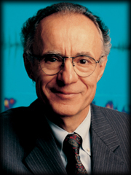
Nobel Prize Winner in Physics
Discovered Radiation Afterglow of the Big Bang
“Astronomy leads us to a unique event, a universe which was created out of nothing, one with the very delicate balance needed to provide exactly the right conditions required to permit life, and one which has an underlying, one might say ‘supernatural,’ plan.”
Arno Penzias
Nobel Laureate
Notes:
35

Slide 36
THE TWO FUNDAMENTAL
origin questions
WHAT CAUSED THE:
1. Universe ?
2. Life ?
Notes:
36

Slide 37

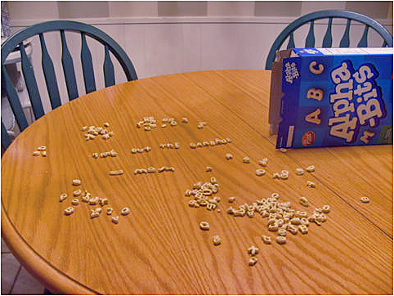
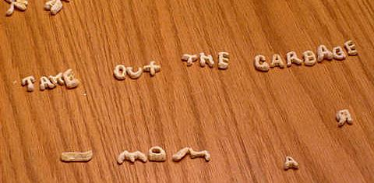
INTELLIGENT DESIGN
from an intelligent being
MOM!
Notes:
37

Slide 38
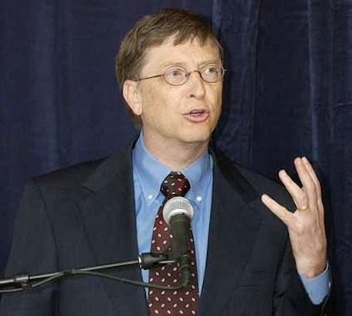
WHAT IS THE SOURCE OF INFORMATION?
It’s Immaterial with an Intelligent Source
“DNA is a like a computer program but far, far more advanced than any software ever created.”
Bill Gates

Slide 39

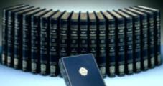
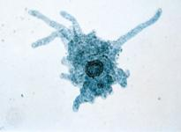
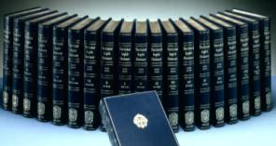
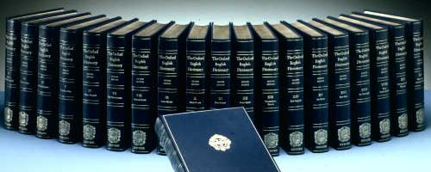
Equal to 1,000 Volumes of an Encyclopedia!
FIRST LIFE REQUIRES
an intelligent cause
Notes:
39

Slide 40
THREE GREAT ARGUMENTS
for a theistic God
BEGINNING:
DESIGN:
MORALITY:
Cosmological Argument
Teleological Argument
Moral Argument
Notes:
40
WARNING about the next side!

Slide 41
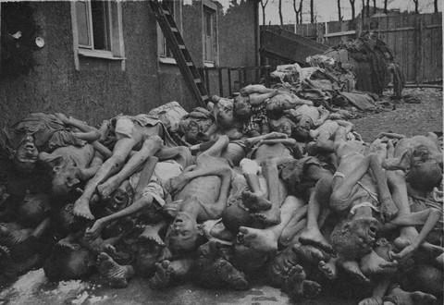
Notes:
41

Slide 42
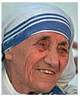
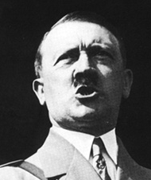
HOW DO YOU DISCOVER
who’s right & who’s wrong?

Slide 43
The Real, Unchanging Scotland
MAPS OF SCOTLAND
Map - A
Map - B

Slide 44

If There is no God…
The Nazis were not wrong
Love is no better than rape
There are no human rights
Religious crusades are not wrong
Tolerance is no better than intolerance
Can’t complain about the problem of evil

Slide 45
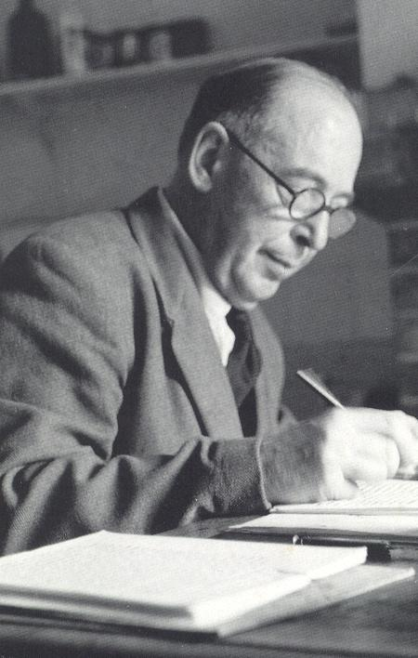
Evil Requires Good
Good Requires God
“{As an atheist} my argument against God was that the universe seemed so cruel and unjust. But how had I got this idea of just and unjust? A man does not call a line crooked unless he has some idea of a straight line. What was I comparing this universe with when I called it unjust?”
“A commonsense inter-pretation of the facts suggests that a super intellect has monkeyed with physics, as well as chemistry and biology, and that there are no blind forces worth speaking about in nature.”
Straight Line = Standard
C.S. Lewis
Mere Christianity, p 45.

Slide 46
Does Truth Exist?
Are Miracles Possible?
Is the New Testament Reliable?
Does God Exist?

Slide 47
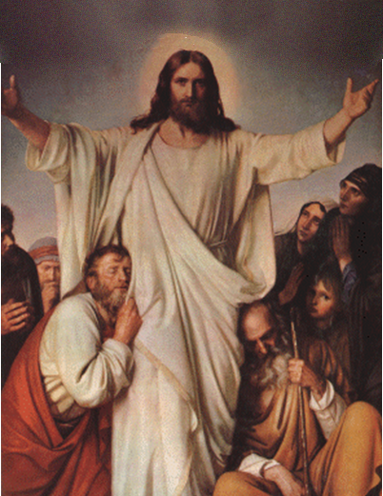
WHY MIRACLES?
The miracle confirms the message.
The sign confirms the sermon.
Most Biblical miracles confirm:
Moses
Elijah & Elisha
Jesus & Apostles

Slide 48
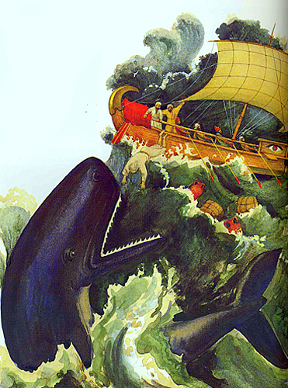
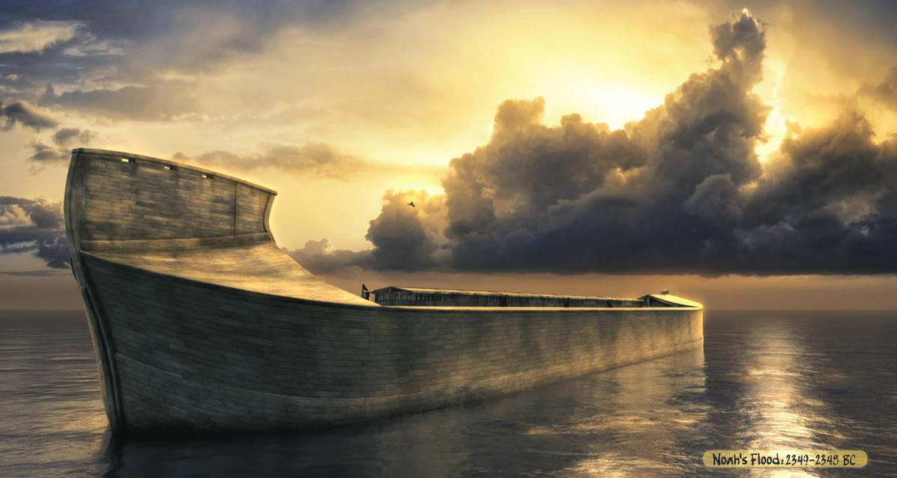
SOME BELIEVE
miracles are impossible
The miracle confirms the message.
The sign confirms the sermon.
Most Biblical miracles confirm:
Moses
Elijah & Elisha
Jesus & Apostles

Slide 49
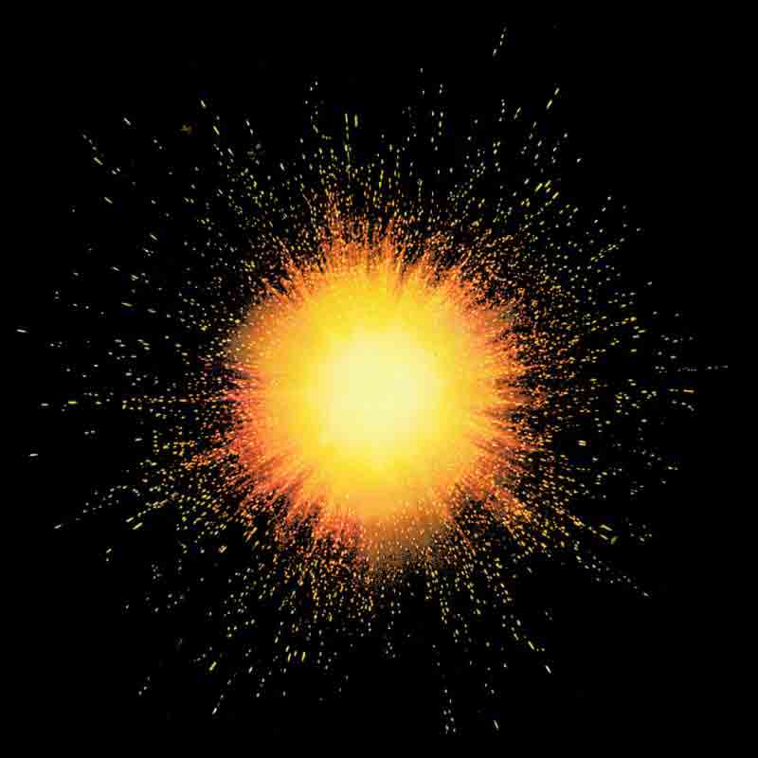
BUT, SINCE THE GREATEST
miracle has already occurred

Slide 50
...EVERY OTHER MIRACLE
is believable!
The miracle confirms the message.
The sign confirms the sermon.
Most Biblical miracles confirm:
Moses
Elijah & Elisha
Jesus & Apostles

Slide 51
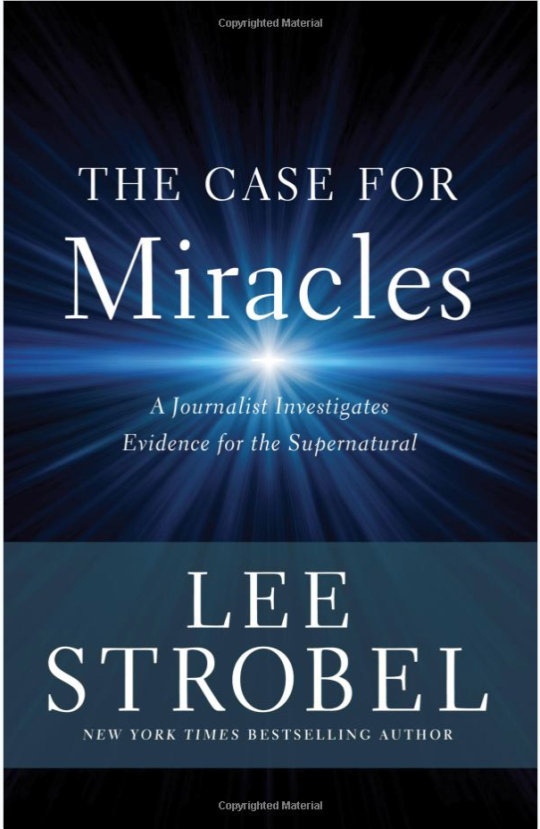
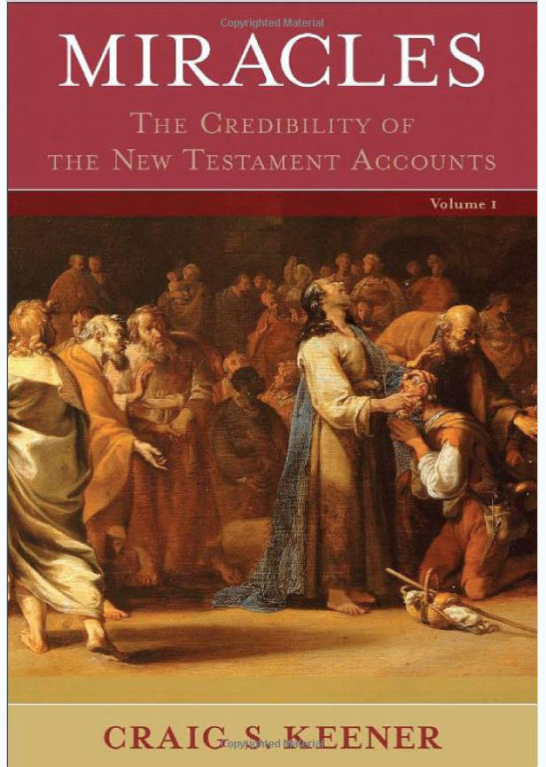

Are there examples of
Modern day miracles?

Slide 52
Does Truth Exist?
Are Miracles Possible?
Is the New Testament Reliable?
Does God Exist?

Slide 53
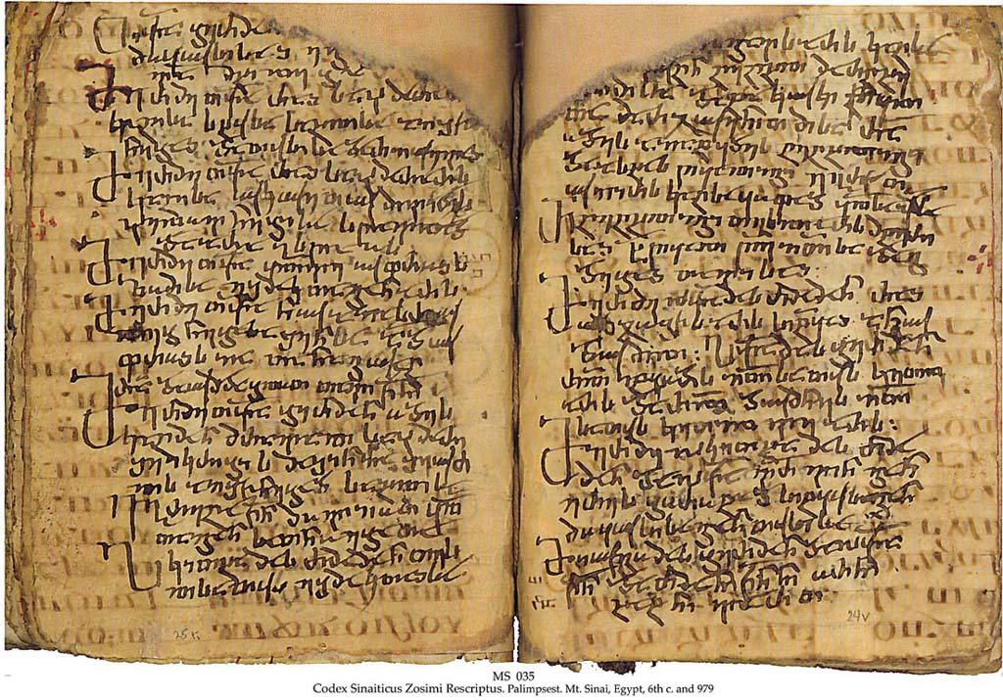
TWO QUESTIONS
for investigating the reliability of the New Testament
1. Do we have an accurate copy of the original NT documents?
2. Do the original NT documents tell the truth?

Slide 54
What is the New Testament?
Twenty-seven individual, hand-written documents (autographs), abt. 12 different authors, written in Koine Greek
The Gospels & Acts (Matt, Mark, Luke, John, Acts)
Letters & Epistles of Paul
The General Epistles (James, Peter, John, Jude)

Slide 55
What is the New Testament?
Thousands of hand-written copies were made and in circulation in the Mediterranean region
We do not have the originals... …but this is actually ok!

Slide 56
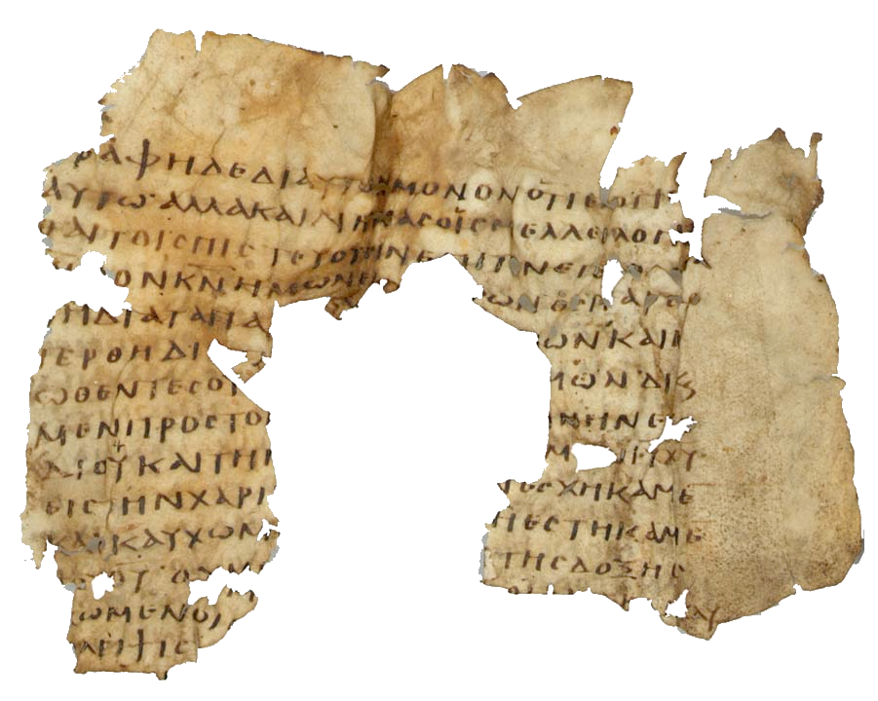
HOW DO WE KNOW WE HAVE
an accurate copy of the original NT?
EARLY: 43% of 8,000 NT verses are in Manuscripts earlier than 225 AD
MANY: Over 5,700 Greek & 19,000 manuscripts in other languages (total Greek manuscripts stack over a mile high compared to 4 feet for classical Greek authors).
COOROBORATED: Over 36,000 quotations from early church fathers
COPIED: 99.5% accurate
Notes:
56

Slide 57

How do we know what the original said?
ORIGINAL
MANUSCRIPT
COPY 1
COPY 2
COPY 3
COPY 4
Copy 1: God is #ust and the justifier of the one who has faith in Jesus.
Copy 2: God is j#st and the justifier of the one who has faith in Jesus.
Copy 3: God is ju#t and the justifier of the one who has faith in Jesus.
Copy 4: God is jus# and the justifier of the one who has faith in Jesus.
Original: God is just and the justifier of the one who has faith in Jesus.
The NT Documents Have Far Fewer Variations Than This Example
Notes:
57

Slide 58
TWO QUESTIONS
for investigating the reliability of the New Testament
1. Do we have an accurate copy of the original NT documents?
2. Do the original NT documents tell the truth?

Slide 59
THE SIX E’s
evidence the NT is true
Early Testimony
Eyewitness Testimony
Embarrassing Testimony
Excruciating Testimony
Expected Testimony
Extra-Biblical Testimony

Slide 60
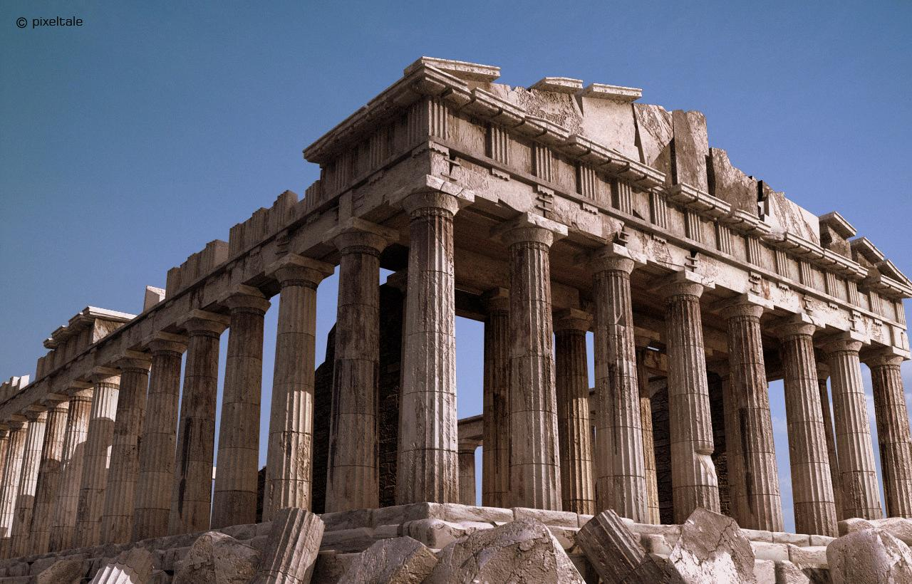
1. EARLY TESTIMONY
CROSS
T EMP L E
1 Corinthians
Creed
Acts
James
Paul
30
40
50
60
70
Mark
Luke
Romans, 2 Corinthians, Galatians
Most or all NT
AGE OF EYEWITNESSES
Notes:
60

Slide 61
1. EARLY TESTIMONY
CROSS
T EMP L E
Creed
1 Corinthians
Acts
James
Paul
30
40
50
60
70
Mark
Luke
Romans, 2 Corinthians, Galatians
Most or all NT
AGE OF EYEWITNESSES
Notes:
61
The books of the NT are bracketed by two very important, and extremely well attested to events: the cross ~ AD 30-33 and the destruction of the temple AD 70.
Bible is not just a collection of writings, but many of these were based on creeds and other oral traditions.
Many if not all of Paul’s letters in epistles were written by the mid-60’s. Why? Scholars say he died in the mid-60’s.
Acts was written by 62 AD, which means Luke was written prior (see Acts 1:1). Luke draws on other sources, including Mark.
Paul wrote 1 Cor in 55 AD. The creed in 1 Cor 15 dates back to within a few year (some scholars think even within 6 months) of the cross.

Slide 62
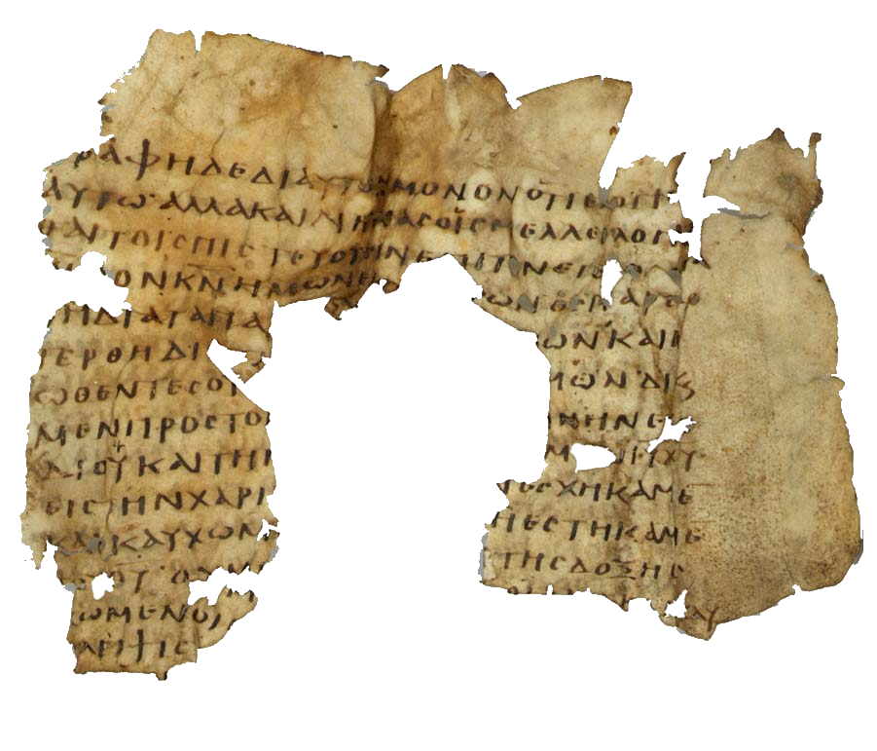
THE SIX E’s
evidence the NT is true
Early Testimony
Eyewitness Testimony
Embarrassing Testimony
Excruciating Testimony
Expected Testimony
Extra-Biblical Testimony

Slide 63
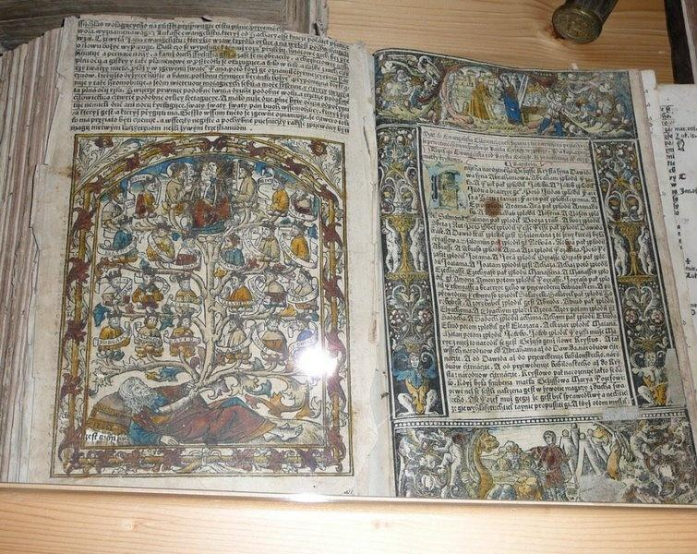
2. EYE WITNESS TESTIMONY
historical crosshairs in the text
“In the fifteenth year of the reign of Tiberius Caesar–when Pontius Pilate was governor of Judea, Herod tetrarch of Galilee, his brother Philip tetrarch of Iturea and Traconitis, and Lysanias tetrarch of Abilene–during the high priesthood of Annas and Caiaphas, the word of God came to John son of Zechariah in the desert.” ~ Luke 3:1-2
Does it sound like he’s making up a story?
An exact date is given--A.D. 29.
All eight people are known from history.
All were known to live at this exact time.
This is not a “Once Upon A Time” story (myth).

Slide 64
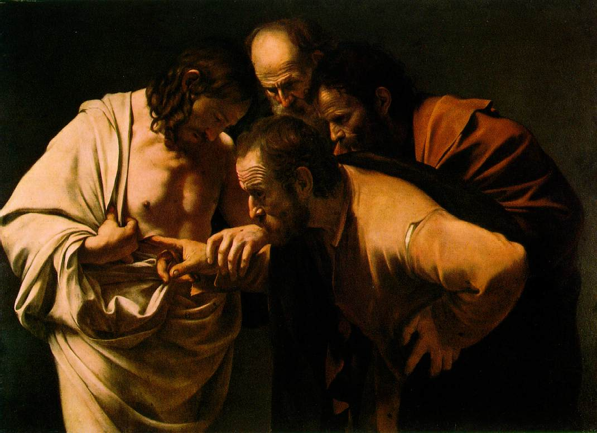
2. EYE WITNESS TESTIMONY
numerous confirmed eyewitness details
Acts -- 84 historically-confirmed eyewitness details.

Slide 65
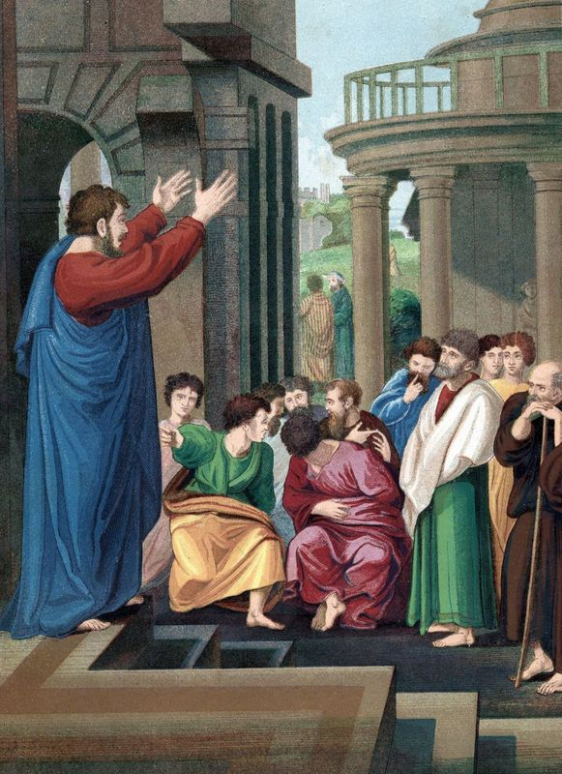
Scholars say:
Acts Is Authoritative
“I began with a mind unfavorable to it [Acts]….;but more recently I found myself brought into contact with the book of Acts as an authority for the topography, antiquities, and society of Asia Minor. It was gradually borne in upon me that in various details the narrative showed marvelous truth.”
(Archaeologist William Ramsey, St. Paul the Traveler and Roman Citizen, p. 8)
Notes:
Famous classical scholar and archaeologist Sir William Ramsey.

Slide 66
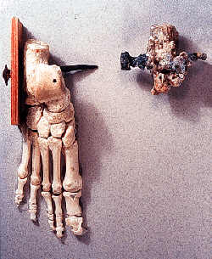
CRUCIFIXION VICTIM 1ST CENTURY A.D.
discovered in Jerusalem

Slide 67
THE SIX E’s
evidence the NT is true
Early Testimony
Eyewitness Testimony
Embarrassing Testimony
Excruciating Testimony
Expected Testimony
Extra-Biblical Testimony

Slide 68
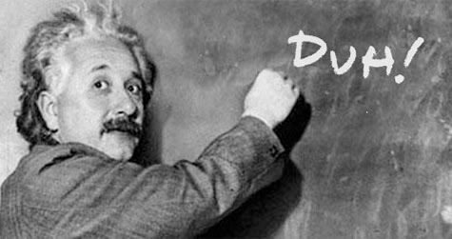
3. EMBARRASSING TESTIMONY
They Are Dim-witted
They fail to understand what Jesus is saying. (Mark 9:32, Luke 18:34, John 12:16)
They Are Uncaring
They fall asleep on Jesus twice.
They make no effort to give Jesus a proper burial.
They Are Rebuked
Peter is called “Satan” by Jesus. (Mark 8:33)
Paul rebukes Peter for being wrong about a theological issue. (Gal 2:11)
Notes:
I’ll delay about the principle of embarrassment.
You’ll have to animate these individually

Slide 69
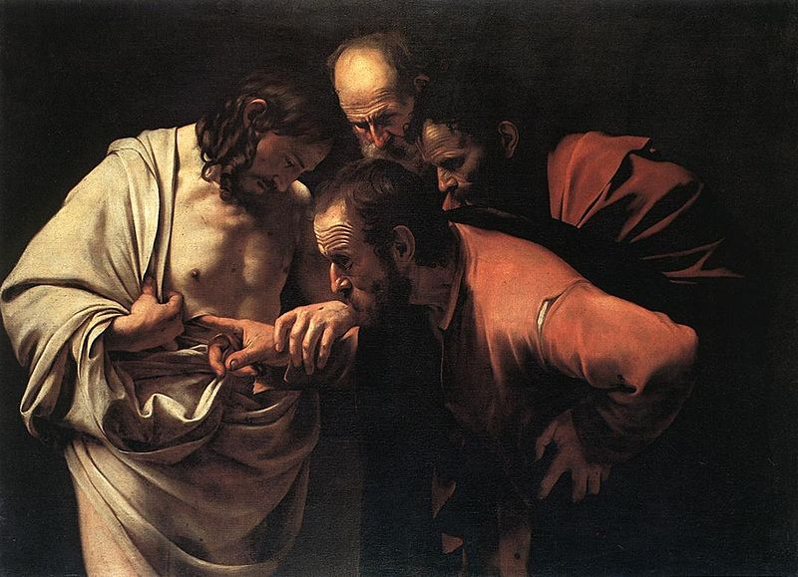
3. EMBARRASSING TESTIMONY
They Are Cowards
Peter denies Christ three times.
The disciples run away!
The women are the brave ones.
They Are Doubters
Despite being taught several times that Jesus would rise from the dead (John 2:18, 3:14-18; Matt. 12:39-41; 17:9, 22-23), the disciples are doubtful when they hear of his resurrection.
Some are even doubtful after they see Him risen (Matt. 28:17)!
Notes:
I will delay after “The woman are the brave ones” – can go to camera.
I will delay after the last point too.

Slide 70
THE SIX E’s
evidence the NT is true
Early Testimony
Eyewitness Testimony
Embarrassing Testimony
Excruciating Testimony
Expected Testimony
Extra-Biblical Testimony

Slide 71
6. EXTRA-BIBLICAL TESTIMONY
basic NT storyline confirmed by non-Christian sources
10 ancient non-Christian sources including:
Historians: Josephus, Tacitus, Suetonius, Thallus, Phlegon
Government Officials: Pliny the Younger, Emperor Trajan, Emperor Hadrian
Other Sources including The Jewish Talmud and Greek writer Lucian
Compiling their references, we get a story congruent with the New Testament…
Notes:
71

Slide 72
6. EXTRA-BIBLICAL TESTIMONY
basic NT storyline confirmed by non-Christian sources
Jesus lived during time of Tiberius Caesar.
He lived a virtuous life.
He was a wonder-worker.
He had a brother named James.
He was acclaimed to be the Messiah.
He was crucified under Pontius Pilate.
An eclipse & earthquake occurred when He died.
He was crucified on the eve of the Passover.
His disciples believed He rose from the dead.
His disciples were willing to die for their belief.
Christianity spread rapidly as far as Rome.
His disciples denied the Roman gods and worshiped Jesus as God
THIS IS WHAT THE NT SAYS!
Notes:
72

Slide 73
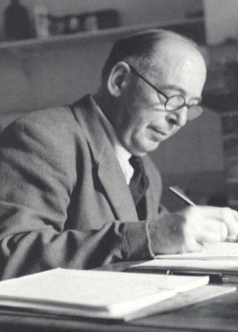
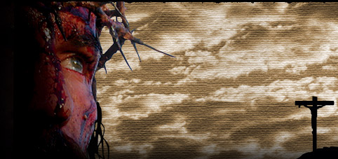
Who is JESUS?
“I am trying here to prevent anyone saying the really foolish things that people often say about Him: ‘I'm ready to accept Jesus as a great moral teacher, but I don't accept His claim to be God.’ That is the one thing we must not say.
C.S. Lewis
Mere Christianity, pp. 55-56
A man who was merely a man and said the sort of things Jesus said would not be a great moral teacher. He would rather be a lunatic - on a level with the man who says he is a poached egg ― or else he would be the Devil of Hell…”
Notes:
73

Slide 74
Who is JESUS?
“…You must make your choice. Either this man was, and is, the Son of God: or else a madman or something worse. You can shut Him up for a fool, you can spit at Him and kill Him as a demon; or you can fall at His feet and call
C.S. Lewis
Mere Christianity, pp. 55-56
Him Lord and God. But let us not come with any patronizing nonsense about His being a great human teacher. He has not left that open to us. He did not intend to.”
Notes:
74

Slide 75
Does Truth Exist?
Are Miracles Possible?
Is the New Testament Reliable?
Does God Exist?

Slide 76
Final thoughts
It’s not about winning arguments, it’s about showing people that Christianity is true
The Holy Spirit convicts and converts
People are often confused about what Christianity actually is
It is not myth, ledged or fairy tale
It is based on actual historic events (1 Corinthians 15:14)
Our job is to point them to the truth!
Notes:
And if Christ has not been raised, then our preaching is in vain and your faith is in vain.

Slide 77
Stuart Smith
✉stuart@apologeticsgeek.com
https://www.apologeticsgeek.com

